Slide 1
SQL Lesson 8a
Single-Row Functions Part 1
V1.0 2020

Slide 2
Lesson Objectives
After completing this lesson you will
Know the difference between single-row and group functions
Know when to use character, number, and date single-row functions
Understand how the Oracle database works with date data
Understand the difference between date and timestamp data

Slide 3
Single-row functions
Introduction
Character functions
Number functions
Working with dates
Timestamp data
Date functions

Slide 4
Input rows Output rows
SQL functions
All SQL functions return one value.
Many functions accept input arguments.
Single-Row Functions return one value for each input row.
Group Functions return one row for every group of input rows.
Group Functions will be covered in Lesson 10a Aggregating Data Using Group Functions.
Single-Row SQL Function

Slide 5
Single-row functions
Return one output row per input row
Can be nested inside each other
Input arguments can be columns or expressions
Are typically used in the SELECT and WHERE clauses
function_name [(arg1, arg2, …)]

Slide 6
Single-row functions
This lesson | Next lesson
Character data functions | Datatype conversion functions
Number data functions | Nulls function
Date data functions

Slide 7
Single-row functions
Introduction
Character functions
Number functions
Working with dates
Timestamp data
Date functions

Slide 8
Character functions
Can be sub-categorized
Case conversion functions
Character manipulation functions
lower
upper
initcap
concat
substr
length
instr
lpad and rpad
trim
replace

Slide 9
These functions convert the case for character strings
Character functions
Case conversion functions
Function | Result
LOWER(‘FDM Group’) | fdm group
UPPER(‘FDM Group’) | FDM GROUP
INITCAP(‘FDM Group’) | Fdm Group

Slide 10
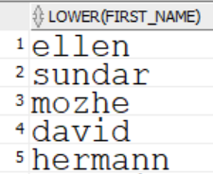
Character functions
Case conversion functions
Change the output character data to lower case
SELECT LOWER(first_name)
FROM employees;
…

Slide 11
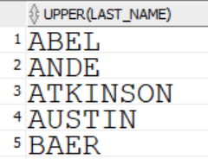
Character functions
Case conversion functions
Change the output character data to upper case
SELECT UPPER(last_name)
FROM employees;
…

Slide 12
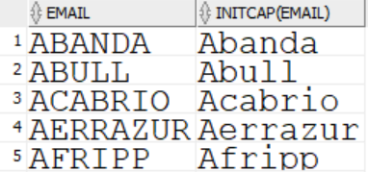
Character functions
Case conversion functions
Change the output character data to capitalized initials
SELECT email, INITCAP(email)
FROM employees;
…

Slide 13
These functions manipulate character strings:
Character functions
Character manipulation functions
Function | Result
CONCAT(‘FDM’ , ‘Group’) | FDMGroup
SUBSTR(‘FDM Group’, 1, 5) | FDM G
LENGTH(‘FDM Group’) | 9
INSTR(‘FDM Group’ , ‘r’) | 6
LPAD(salary, 10, ‘*’) | *****24000
RPAD(salary, 10, ‘*’) | 24000*****
REPLACE(‘FDM Group’, ‘FD’ , ‘MG’) | MGM Group
TRIM(‘F’ from ‘FDM Group’) | DM Group

Slide 14
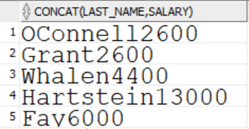
Character functions
Character manipulation functions
CONCAT will concatenate two values
Its output is a character string
SELECT CONCAT(last_name, salary)
FROM employees;
…

Slide 15
Character functions
Character manipulation functions
SUBSTR extracts a string of a specified length
The format is SUBSTR(column, starting position, length)
If starting position is negative, the count starts from the end
If length is omitted, it returns all characters to the end of the string

Slide 16
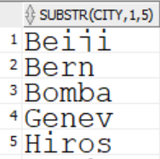
Character functions
Character manipulation functions
Use SUBSTR to return the first 5 characters of the city
SELECT SUBSTR(city, 1, 5)
FROM locations;
…

Slide 17
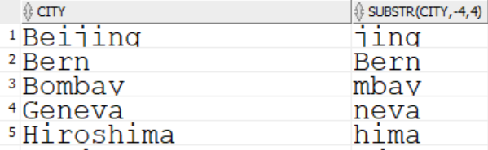
Character functions
Character manipulation functions
Use SUBSTR to return the last 4 characters of the city
SELECT city, SUBSTR(city, -4, 4)
FROM locations;
…

Slide 18
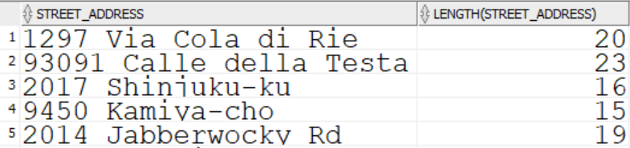
Character functions
Character manipulation functions
LENGTH returns the length of a string as a numeric value
SELECT street_address, LENGTH(street_address)
FROM locations;
…

Slide 19
Character functions
Character manipulation functions
INSTR returns the numeric position of a substring
The format is INSTR(column, ‘string’ , beginning position , occurrence)
0 is returned if the substring is not found
Optionally, you can provide
- The position where you want the search to start. Position 1 is the default
- Which occurrence you want searched for. 1st occurrence is the default

Slide 20
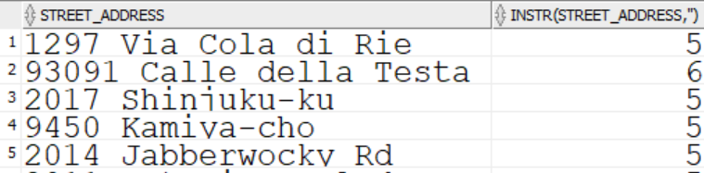
Character functions
Character manipulation functions
INSTR will find the location of the first space in the street_address
SELECT street_address, INSTR(street_address, ' ')
FROM locations;
…

Slide 21
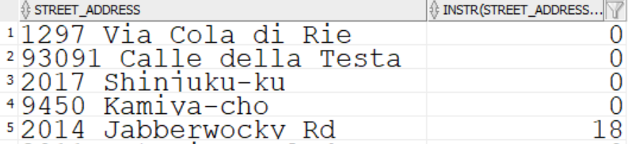
Character functions
Character manipulation functions
INSTR will find the location of Rd in the street_address
SELECT street_address, INSTR(street_address, 'Rd')
FROM locations;
…

Slide 22
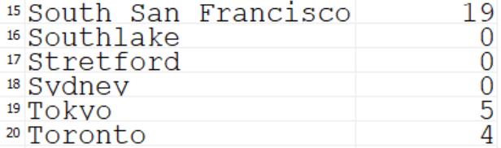
Character functions
Character manipulation functions
INSTR will find the location of second o in the city
SELECT city, INSTR(city, 'o' , 1, 2)
FROM locations;
…

Slide 23
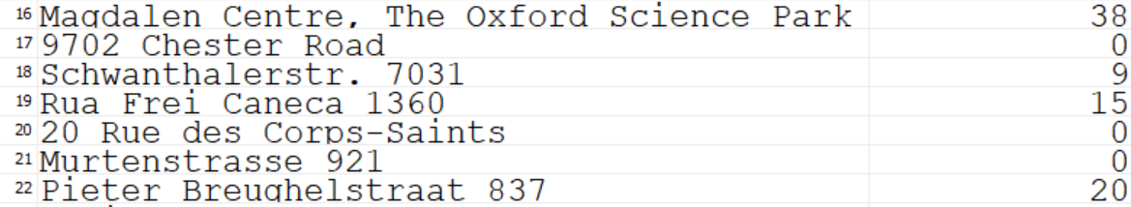
Character functions
Character manipulation functions
INSTR will find the location of the second a in the street address beginning the search at position 5
SELECT street_address, INSTR(street_address, 'a' , 5, 2)
FROM locations;
…

Slide 24
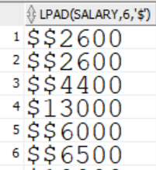
Character functions
Character manipulation functions
Use LPAD and RPAD to pad a column on the left or right with specified character(s) up to a specified length
Pad the salary on the left with $ up to a length of 6 characters
SELECT LPAD(salary, 6, '$')
FROM employees;
…

Slide 25
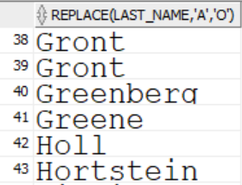
Character functions
Character manipulation functions
REPLACE will replace a character string with another one, in the output only
SELECT REPLACE(last_name, 'a', 'o')
FROM employees;
…

Slide 26
Character functions
Character manipulation functions
Use TRIM to remove LEADING, or TRAILING, or BOTH, characters from a character column
BOTH is the default

Slide 27
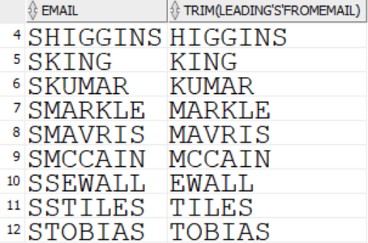
Character functions
Character manipulation functions
TRIM the leading S from email
SELECT email, TRIM(LEADING 'S' FROM email) FROM employees
WHERE email LIKE 'S%' ;
…

Slide 28
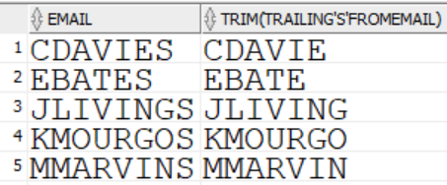
Character functions
Character manipulation functions
TRIM the trailing S from email
SELECT email, TRIM(TRAILING 'S' FROM email) FROM employees
WHERE email LIKE '%S';
…

Slide 29
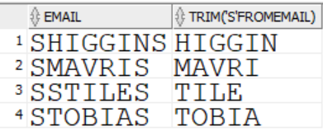
Character functions
Character manipulation functions
TRIM BOTH the leading and training S from email
Because BOTH is the default, it can be omitted
SELECT email, TRIM(BOTH 'S' FROM email)
FROM employees
WHERE email LIKE 'S%S' ;
…

Slide 30
Single-row functions
Introduction
Character functions
Number functions
Working with dates
Timestamp data
Date functions

Slide 31
Number functions
Round: Rounds a value up or down to a specified decimal
Trunc: Rounds a value down to a specified decimal
Mod: Returns the remainder of division
Ceil: Returns the smallest integer greater than a number
Floor: Returns the largest integer less than a number
Function | Result
ROUND(97.928, 2) | 97.93
TRUNC(97.928, 2) | 97.92
MOD(1100, 300) | 200
CEIL(495.3) | 496
FLOOR(653.8) | 653

Slide 32


Number functions
ROUND rounds a number to a specified number of places past the decimal point
0 places is the default
SELECT ROUND(187.8575,2)
FROM DUAL;
TRUNC rounds a number DOWN to a specified number of places past the decimal point
0 places is the default
SELECT TRUNC(187.8575,2)
FROM DUAL;

Slide 33
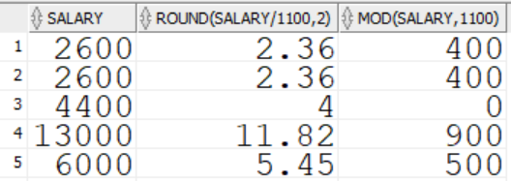
Number functions
MOD returns the remainder of division
SELECT salary, ROUND(salary/1100,2), MOD(salary, 1100)
FROM employees;
…

Slide 34
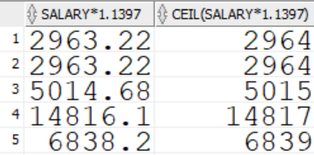
Number functions
CEIL returns the lowest integer greater than a given number
SELECT salary * 1.1397, CEIL(salary * 1.1397)
FROM employees;
…

Slide 35
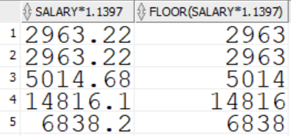
Number functions
FLOOR returns the largest integer smaller than a given number
SELECT salary * 1.1397, FLOOR(salary * 1.1397)
FROM employees;
…

Slide 36
Single-row functions
Introduction
Character functions
Number functions
Working with date data
Timestamp data
Date functions

Slide 37
Working with date data
Oracle displays date data in the DD-MON-RR format
Dates contain century, year, month, day, hour, minute, seconds
Valid dates are between January 1, 4712 BC and December 31, 9999 AD.
Date literals are written inside a pair of single quotes, or ticks.
SELECT last_name, hire_date
FROM employees
WHERE hire_date < '01-JAN-08';

Slide 38
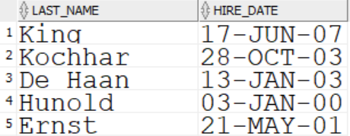
DD-MON-RR default date format
Working with date data
RR assumes a year between:
00-49 | is in this century
50-99 | is in the previous century
SELECT last_name, hire_date
FROM employees
WHERE hire_date < '01-JAN-08';
…

Slide 39

Working with date data
Using the SYSDATE function
The SYSDATE built-in function returns the current date and time at the database
Use the DUAL dummy table to complete the query
SELECT SYSDATE
FROM DUAL;

Slide 40
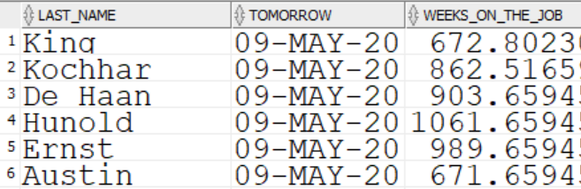
Working with date data
Arithmetic with dates
Add or subtract a number from a date for a date result
Subtract two dates to find the number of days between them
Add hours to a date by dividing the number of hours by 24
SELECT last_name, SYSDATE + 1 as tomorrow, (SYSDATE - hire_date)/7
AS weeks_on_the_job
FROM employees;
…

Slide 41
Single-row functions
Introduction
Character functions
Number functions
Working with date data
Timestamp data
Date functions

Slide 42
Timestamp data
TIMESTAMP data is similar to DATE data.
TIMESTAMP data contains century, year, month, day, hour, minutes, and seconds, just like DATE data.
Additionally, it contains fractions of a second up to nine places past the decimal point.

Slide 43

Timestamp data
The LOCALTIMESTAMP built-in function returns the current TIMESTAMP at the user’s session.
SELECT LOCALTIMESTAMP
FROM employees;

Slide 44
Single-row functions
Introduction
Character functions
Number functions
Working with date data
Timestamp data
Date Functions

Slide 45
Date functions
MONTHS_BETWEEN: Number of months between two dates
ADD_MONTHS: Add a number of months to a date
NEXT_DAY: Next day after a specified date
LAST_DAY: The last day of the month
ROUND: Round a date up or down
TRUNC: Round a date down

Slide 46
Date functions
Function | Result
MONTHS_BETWEEN(‘11-JAN-14’ , ’01-SEP-15’) | 19.674194
ADD_MONTHS(‘31-JAN-16’, 1) | 29-FEB-16
NEXT_DAY(‘01-SEP-15’ , ‘Friday’) | 04-SEP-15
LAST_DAY(‘04-JUL-18’) | 31-JUL-18

Slide 47
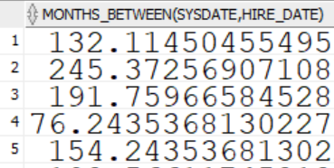
Date functions
MONTHS_BETWEEN returns the number of months between two dates.
SELECT MONTHS_BETWEEN(sysdate, hire_date)
FROM employees;
…
…

Slide 48
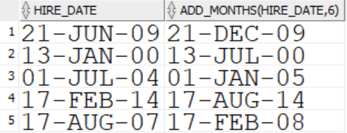
Date functions
ADD_MONTHS adds a specified number of months to a date
SELECT hire_date, ADD_MONTHS(hire_date, 6)
FROM employees;
…

Slide 49
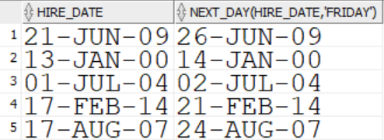
Date functions
NEXT_DAY returns the date of the specified day of the week
SELECT hire_date, NEXT_DAY(hire_date, 'Friday')
FROM employees;
…

Slide 50
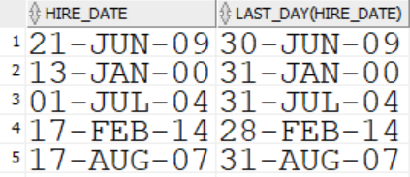
Date functions
LAST_DAY returns the date of the last day of a given month
SELECT hire_date, LAST_DAY(hire_date)
FROM employees;
…

Slide 51
Date functions
Using round and trunc functions with dates
Assume SYSDATE = 31-OCT-19
Function | Result
ROUND(SYSDATE, ‘Year’) | 01-JAN-20
ROUND(SYSDATE, ‘Month’) | 01-NOV-19
TRUNC(SYSDATE, ’Year’) | 01-JAN-19
TRUNC(SYSDATE, ‘Month’) | 01-OCT-19

Slide 52
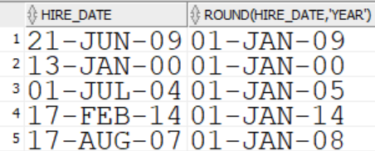
Date functions
ROUND rounds a date to the closest year, month, or day
SELECT hire_date, ROUND(hire_date, 'year')
FROM employees;
…

Slide 53
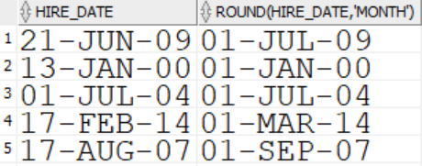
Date functions
ROUND rounds a date to the closest year, month, or day
SELECT hire_date, ROUND(hire_date, 'month')
FROM employees;
…

Slide 54
Date functions
Note that ROUND(date, ‘Month’) rounds down until the 15th
Even February!
Function | Result
ROUND(‘15-FEB-19’ , ‘Month’) | 01-FEB-19
ROUND(‘16-FEB-19’, ‘Month’) | 01-MAR-19

Slide 55
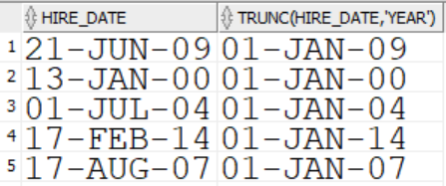
Date functions
TRUNC rounds a date down to the closest year, month, or day
SELECT hire_date, TRUNC(hire_date, 'year')
FROM employees;
…

Slide 56
Quiz
True or false?
Single-row functions…
Manipulate output data values
Accept arguments
Return one value per input row
Return one output row for each group of input rows
Use input arguments that could be a column or a literal

Slide 57
Review
In this lesson you learned how to
Manipulate character data using functions
Perform calculations on numeric data using functions
Understand how the Oracle database works with date data
Handle date manipulation functions

Slide 58
Questions?

